Slide 1
Solar Irradiance Forecasting

Slide 2
Project Overview
Business Understanding
Irradiance is the amount of solar energy that reaches the earth’s surface per unit area. This irradiance is the basis for the calculation of overall power production capacity; forecasting irradiance allows us to forecast production. Accurate irradiance forecasting is essential for renewable energy generators, especially solar power plants, to optimize their energy production and meet regulatory requirements.
In Australia, the grid rewards solar power plants that can predict their expected irradiance (really their power generation capability) for the next 5 minutes. This helps the grid balance the supply and demand of electricity and prevent blackouts or surges. Other countries and regions may soon adopt similar or stricter rules for solar power plants.
Objective
The aim of this project is to accurately forecast irradiance (GHI) with 30 minutes horizon and one minute granularity (IE, predicting t+1, t+2, t+3…, t+30) using provided historical data.
Dataset
Used public dataset from Folsom, California.
Day ahead weather forecasts for closest weather stations (North American Mesoscale Forecast System (NAM))
Satellite imagery from GOES-15
Imagery from Whole Sky Cameras
RGB Ratios from Whole Sky Camera Imagery
Target dataset with irradiance measures at a minutely granularity

Slide 3

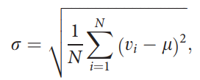
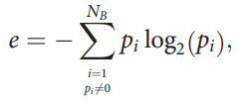
Exploratory data analysis (EDA)
Day ahead weather forecasts for closest weather stations: a public North American Mesoscale Forecast System (NAM) Hourly dataset from Folsom, California (Latitude 38.579454, Longitude -121.260320) includes forecast time period, GHI Downward short-wave radiation flux (W/m2 ), Cloud cover, precipitation, Pressure, components of wind, temperature, Relative humidity with 14980 records.
Satellite imagery from GOES-15 dataset used to extract cloud cover ratio using following equation 1 and Average, Standard Derivation and Entropy features
Cloud Cover Ratio = Number of Cloud Pixels / Total Number of Cloud and Sky Pixels (Eq. 1)
Average (Eq. 2) Standard Derivation (Eq. 3) Entropy (Eq. 4)
Imagery from Whole Sky Cameras used to extract cloud cover ratio using equation 1.
Preprocessing Images:
Convert Fish-Eye Image to flat Image
Detect Solar Position
Convert the image into Color segmentation
Classify the cloud and sky pixels using threshold pixel value
Convert the cloud pixel to cloud cover ratio using Eq.1
RGB Ratios from Whole Sky Camera Imagery includes the red-to-blue components with Average, Standard Derivation and Entropy features.
Target dataset with irradiance measures at a minutely granularity.

Slide 4
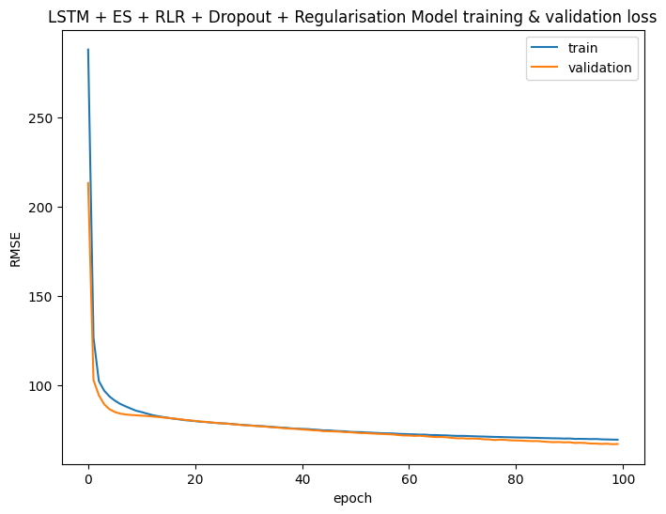
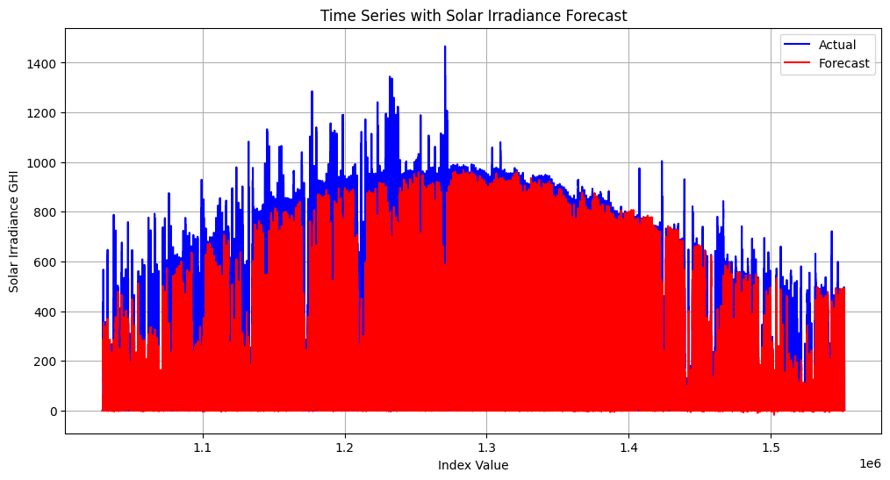
Model Implementation
Data Split Use 2014 and 2015 for training data, and the data from 2016 to test
Data Normalized by Min Max Standardization using MinMaxScaler
Data Lags for forecast irradiance (GHI) with 30 minutes horizon and one minute granularity (IE, predicting t+1, t+2, t+3…, t+30).
LSTM Model Building using Tensorflow
Model Trained on 100 epochs and 3432 (int(trainX.shape[0]/epochs) * 0.10) batch size and calculate loss using Root Mean Square Error.

Slide 5
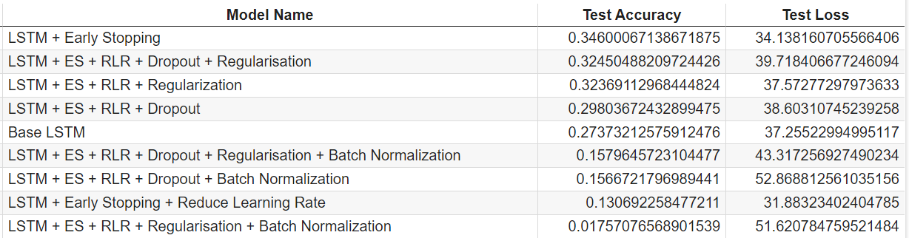
Model Training
Conclusion:
Based on the results of the all plots, we can conclude that the LSTM model with Early Stopping, Reduce Learning Rate, Dropout and Regularization has the best performance. This model has the highest test accuracy and the lowest test loss.

Slide 6
Start
Weather Meteorological Data
Satellite imagery from GOES-15
Whole Sky Cameras Imagery
RGB Ratios from Whole Sky Camera Imagery
GHI Irradiance measures
Linear Correlation Analysis Between GHI and other features
Extract Cloud Cover Ratio and Statistical features
Extract Cloud Cover Ratio and Solar Position Detection features
Analysis Statistical features
Time Series Analysis
Selected features
LSTM with Autoregressive LSTM RNN Model
Predicted Irradiance GHI
End

Slide 7
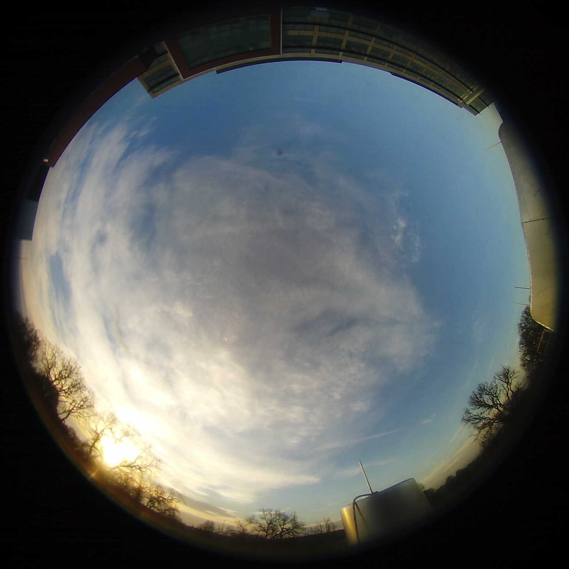
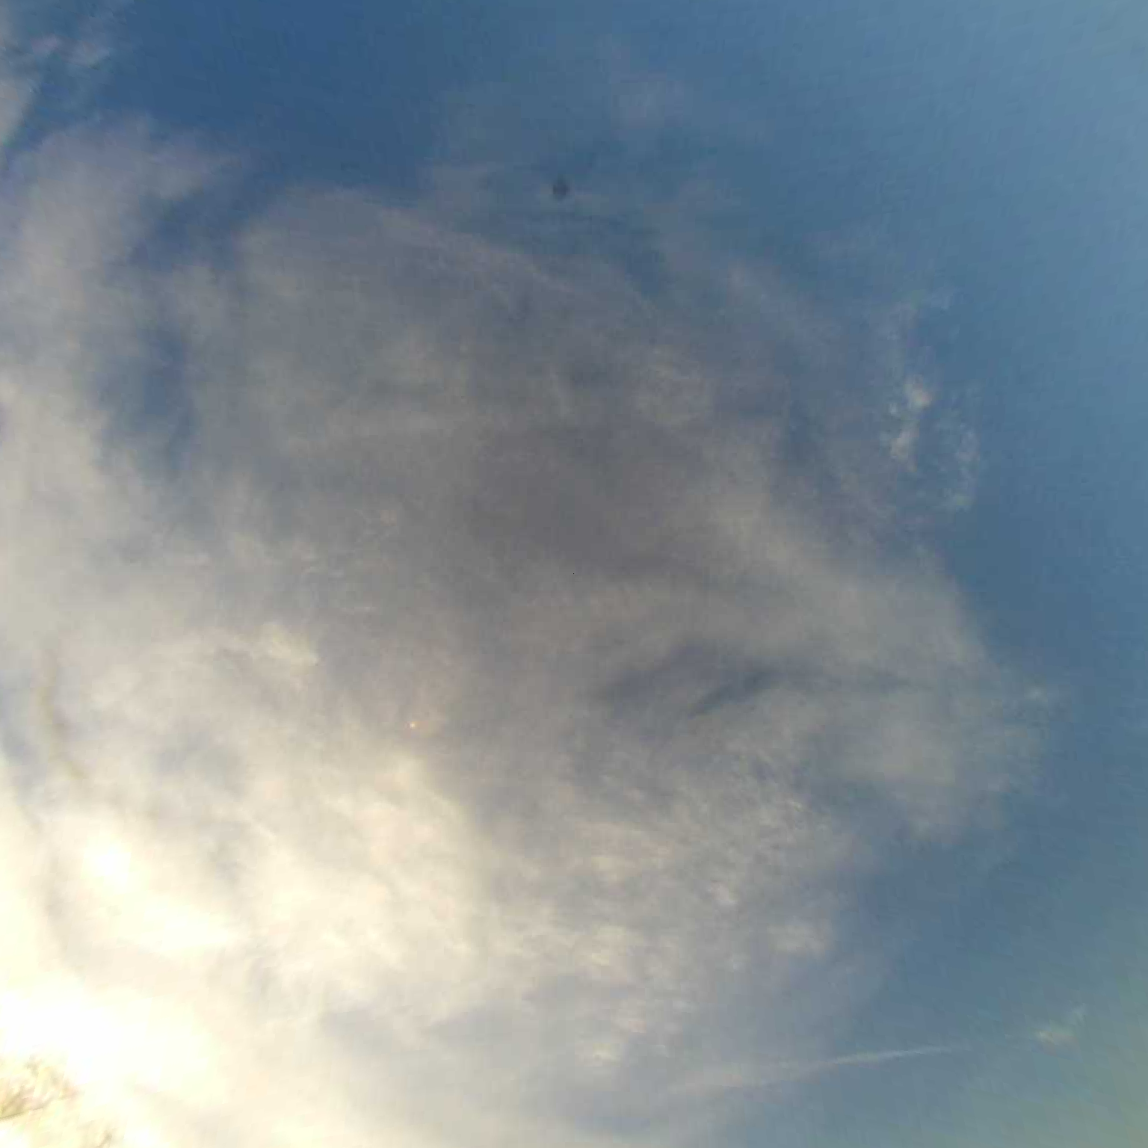
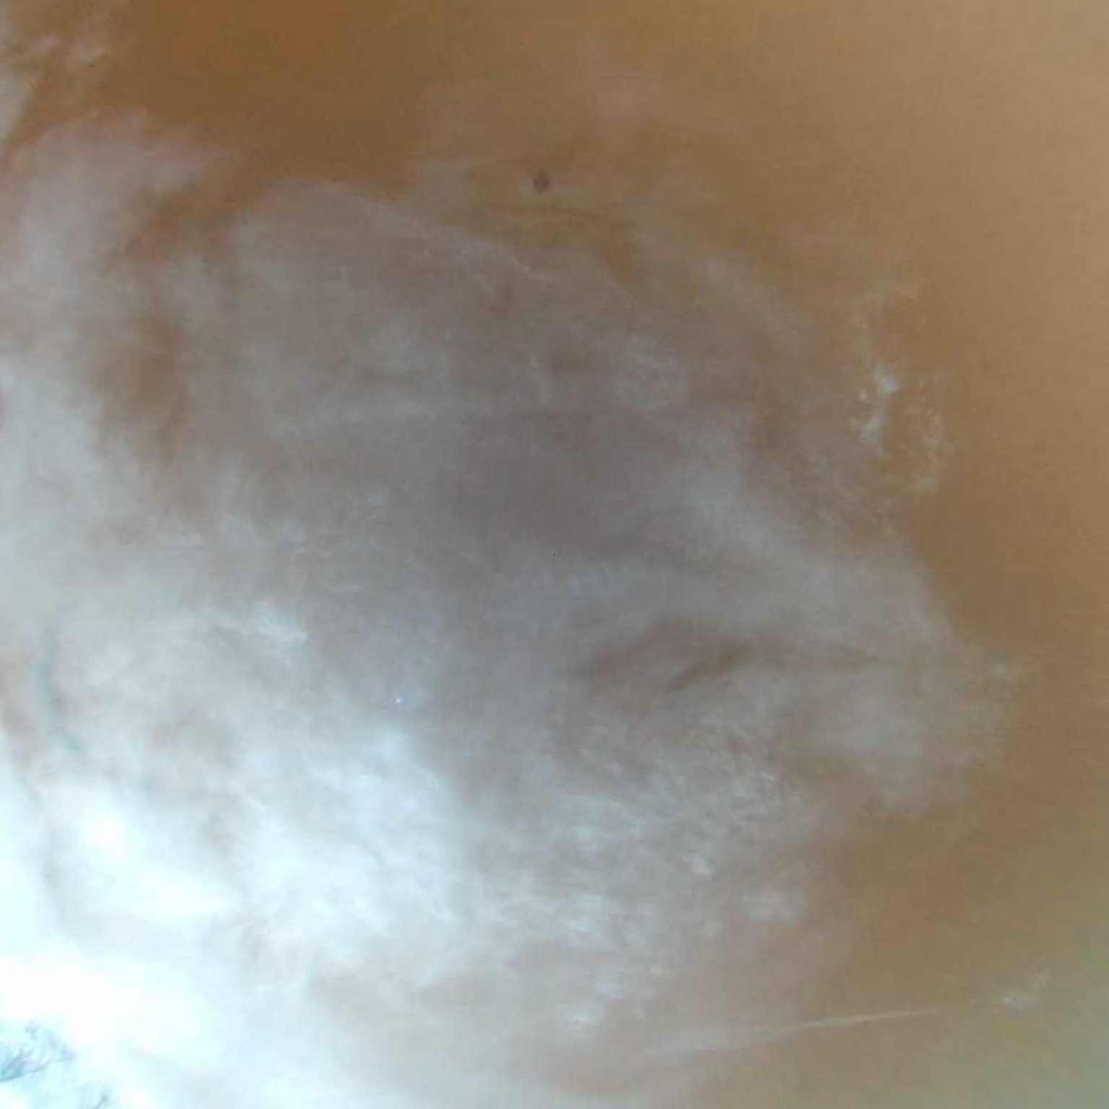

Whole Sky Cameras Imagery Processing
Fish-Eye Image
Flat Image
Colour segmentation
Image Binary Threshold
cloud_cover = (cloud_pixel/total_pixel)*100

Slide 8
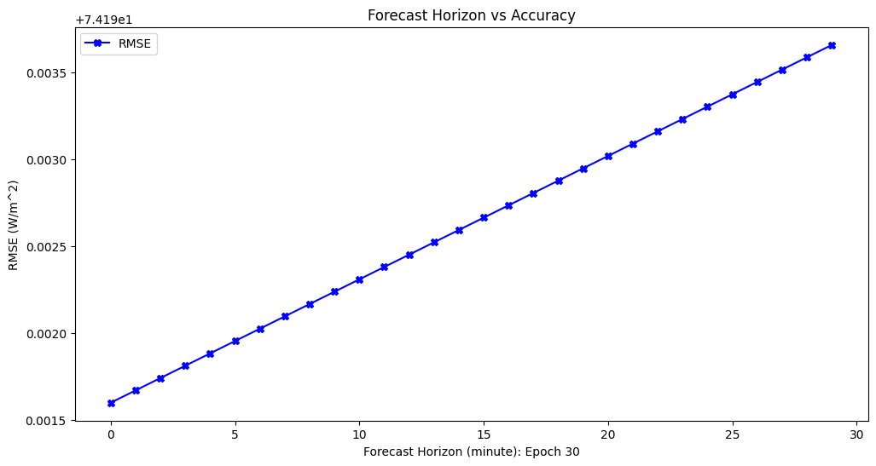
Autoregressive LSTM RNN Model

Slide 9
Question?

